Slide 1

12:34
12:39
12:49
12:52

Slide 2




Slide 4
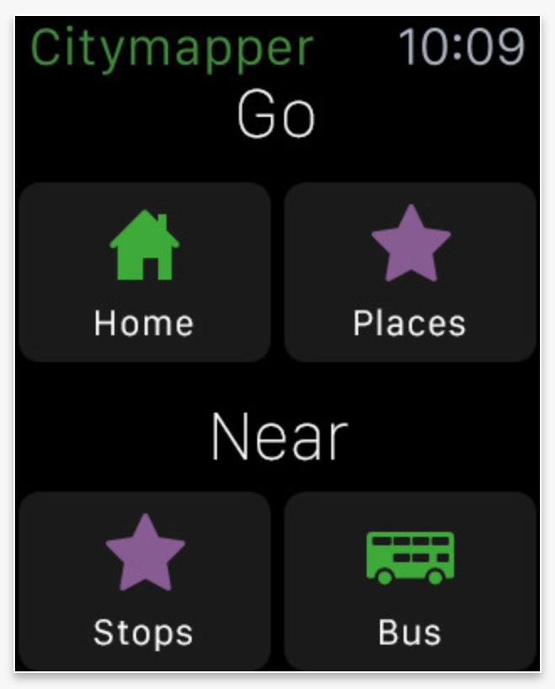
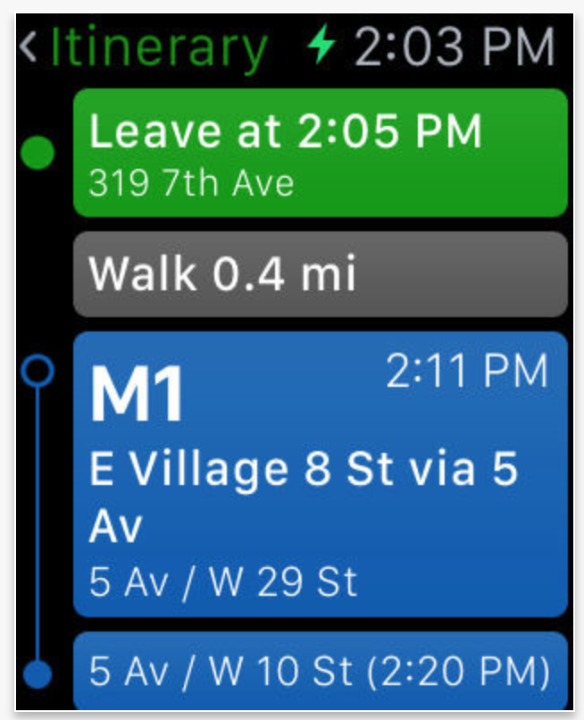


Slide 5


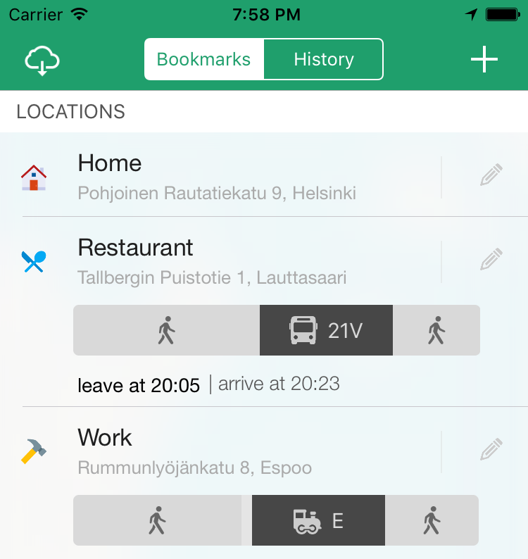

Slide 6



Slide 7


Slide 8








Slide 11


Slide 12
Helsinki 12:30
http://www.fontspace.com/category/thin?p=2
http://www.fontspace.com/nimavisual/trench

Slide 13




Slide 14





Slide 17






Slide 18
M

Slide 19
Mind the rectangle around them. Or else lots of change in code. 1 X 1.5
M

Slide 20


Slide 21



Slide 22


Slide 33



Slide 34


Slide 36








Slide 37





Slide 38


Ewket Apps
®
Ewket Apps
®

Slide 39










Slide 41




Slide 42


Slide 43



Slide 45
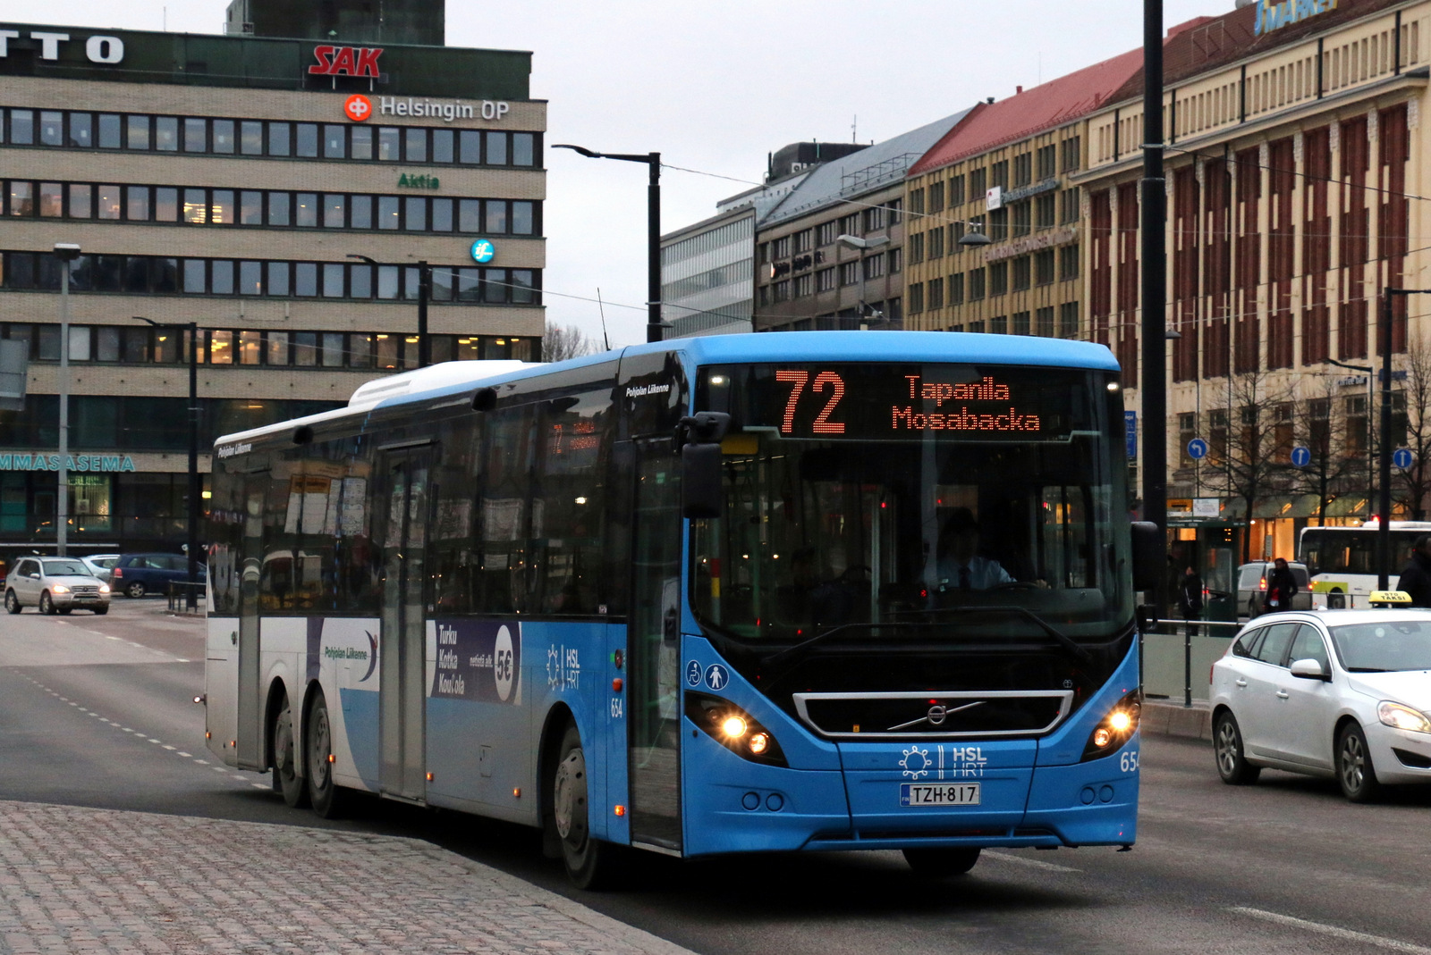


Slide 47


Slide 48
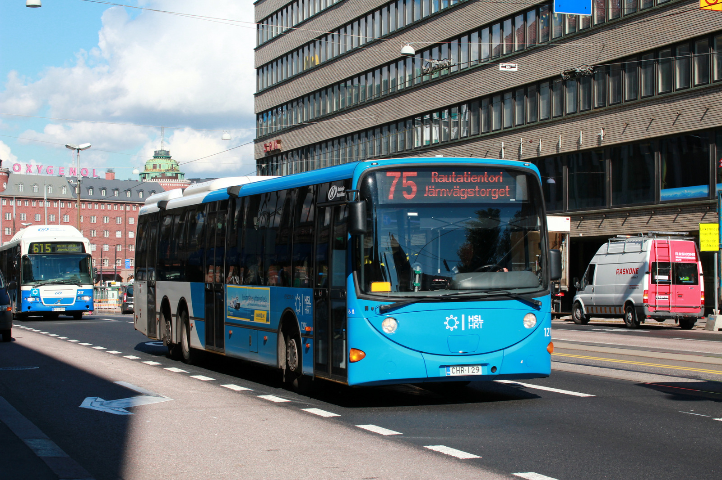

Slide 49
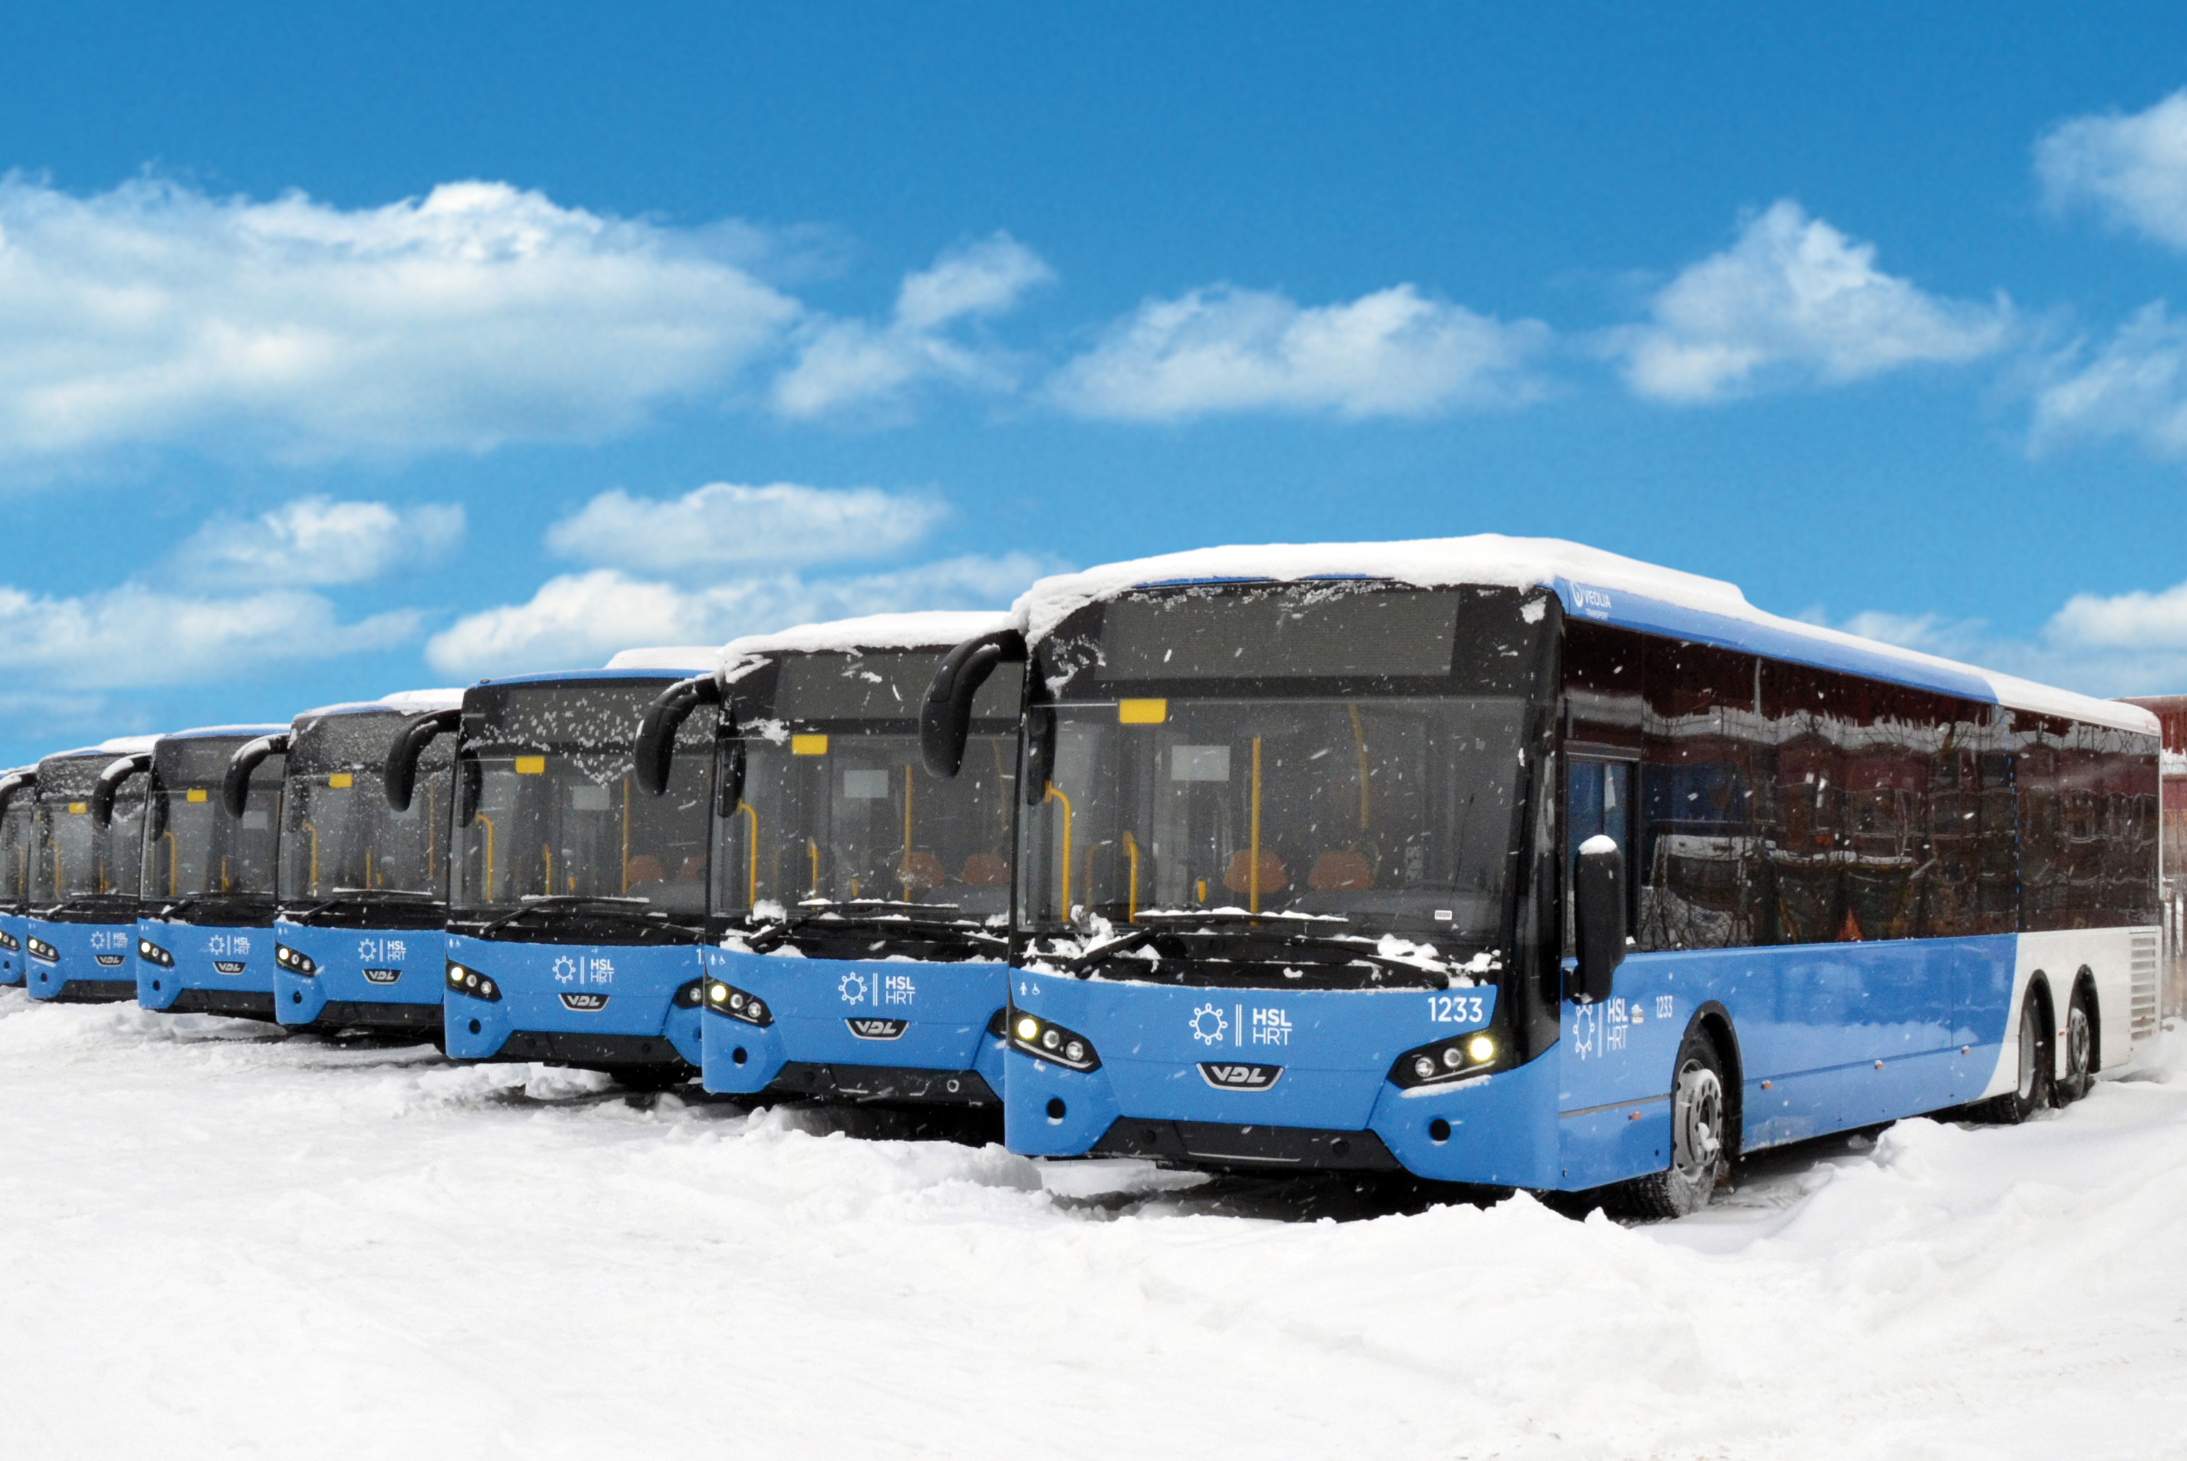

Slide 50


Slide 52
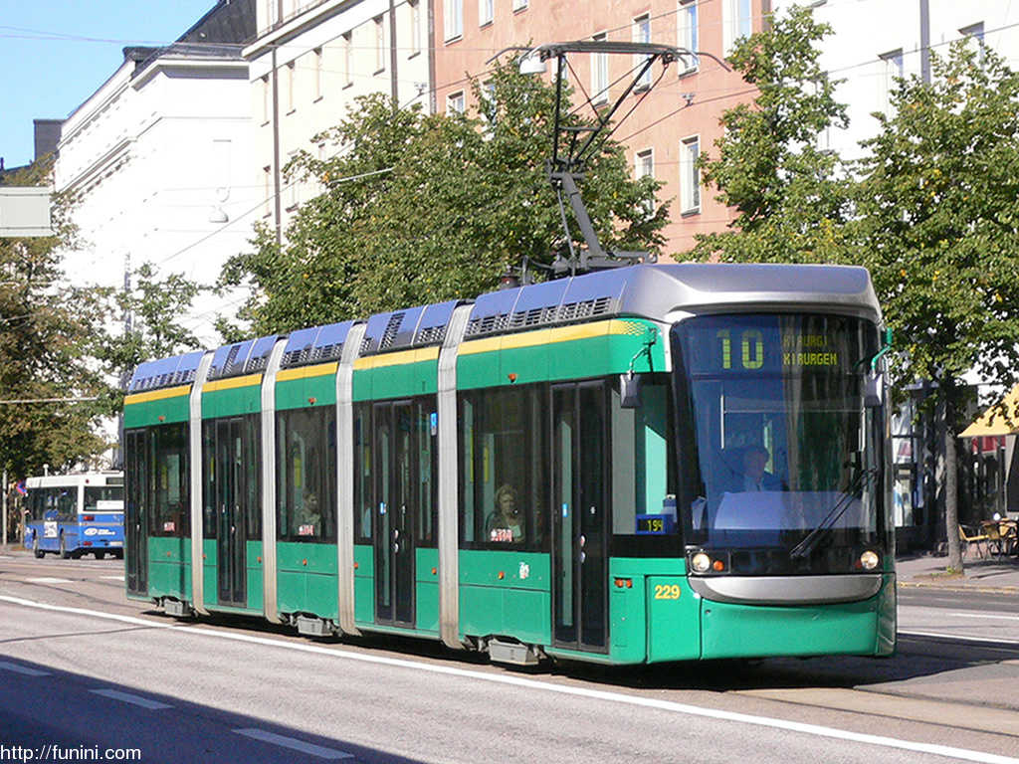

Slide 54


Slide 56
C
B
A - > C
B -> X
X = (b * C)/A
Dif = (A – B)/2
A
C * (1 – B/A)/2

